Slide 1
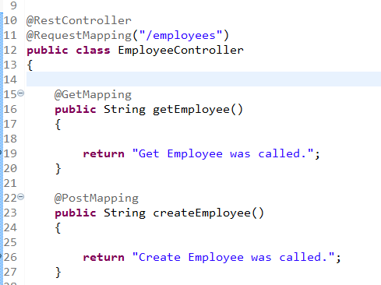
Spring Boot – Adding Methods to Handle POST,GET, PUT, DELETE HTTP requests

